Slide 1
Dual circularly polarized waveguide antenna
Building a first prototype for fabrication

Slide 2
Outline
Introduction
Stage 1 – Polarizer
Choice of parameters, design
Stage 2 – Single waveguide feed
Design verification
Stage 3 – Coaxial feeds
Prototype finalization
Conclusion

Slide 3
Introduction
Material: aluminum
Target frequency band: 5 to 6 GHz
Reference waveguide
Identification: WR159
Inner dimensions: 40.39 x 20.19 mm
Recommended frequency: 4.90 to 7.05 GHz
Cutoff frequency lowest mode: 3.71 GHz

Slide 4
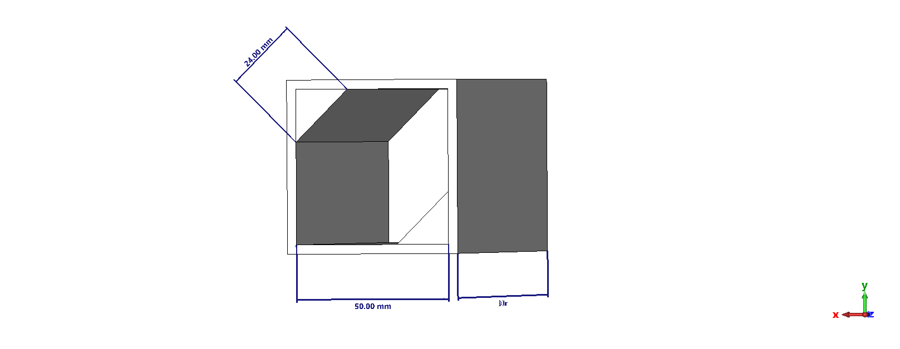
Stage 1: Polarizer

Slide 5
Stage 1 – goals
Similar cutoff frequency to the reference waveguide
Mode amplitude ratio close to 1
Mode phase lag per unit length high as possible
All these goals are in mutual contradiction, so a trade-off decision is required.

Slide 6
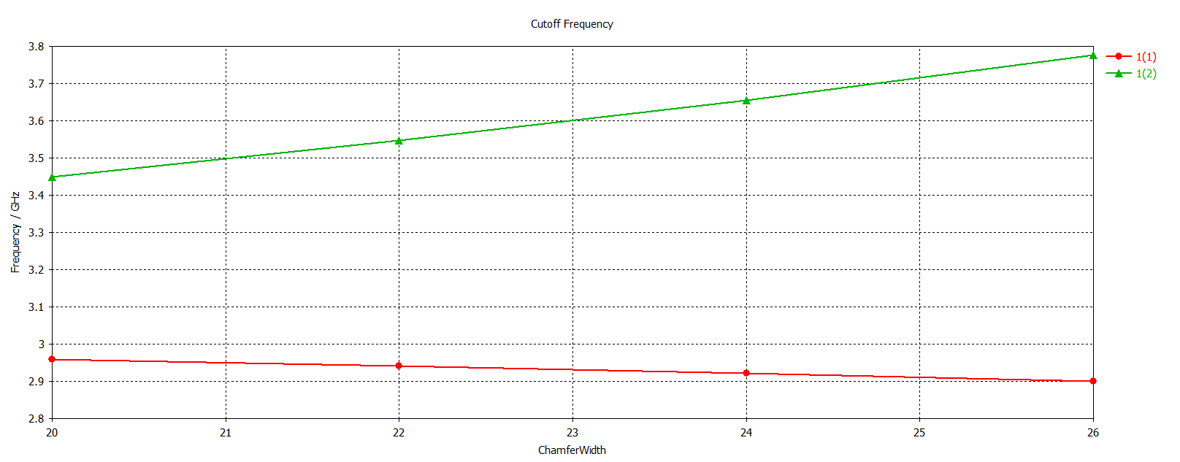
Cutoff frequency

Slide 7
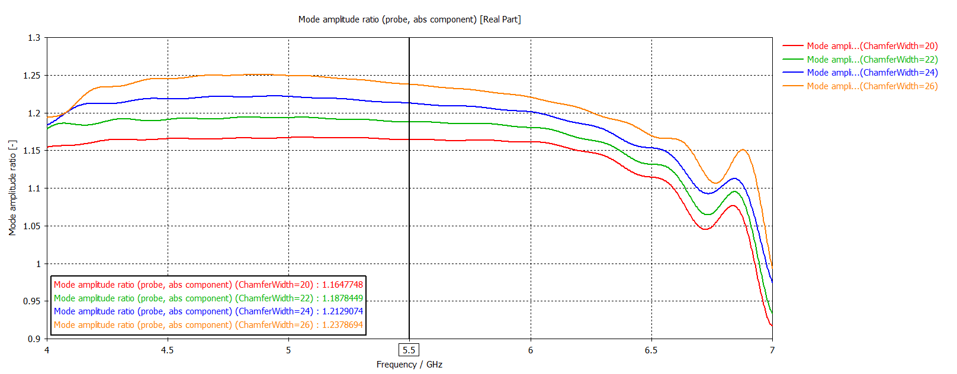
Mode amplitude ratio

Slide 8
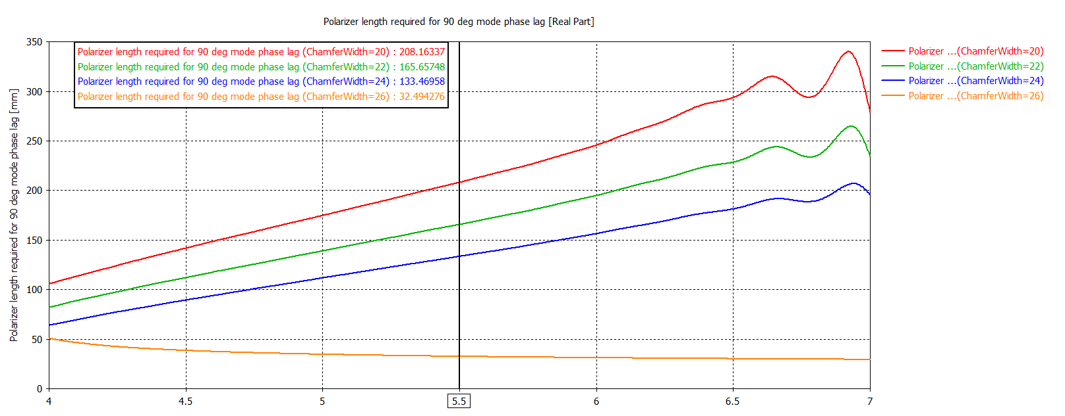
Length required for 90° mode phase lag

Slide 9
Stage 1 – results
My polarizer
Reference waveguide
Side length: 50 mm
Chamfer width: 24 mm
Transversal length: 134 mm
Cutoff frequency: 3.66 GHz
Inner dimensions: 40.39 x 20.19 mm
Cutoff frequency: 3.71 GHz
Recommended frequency: 4.90 to 7.05 GHz

Slide 10
Mode 1

Slide 11
Mode 2

Slide 12
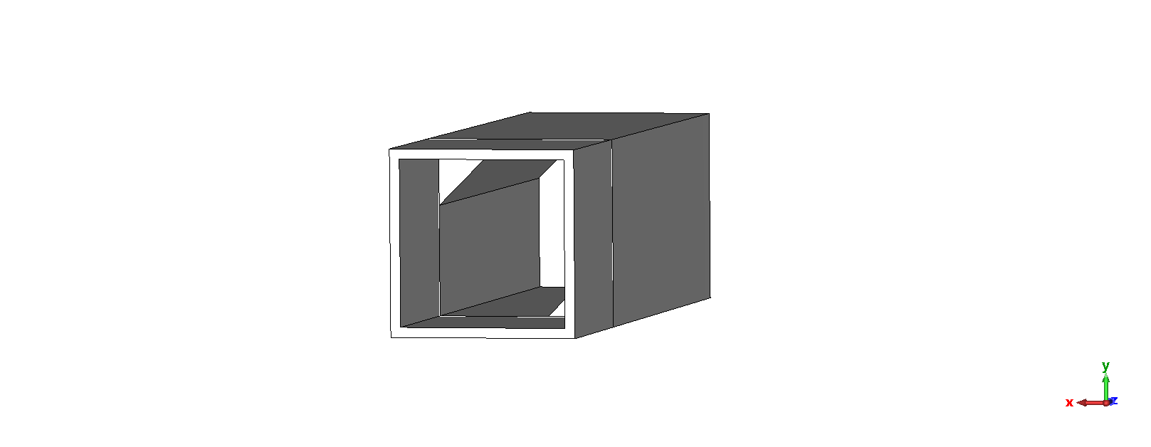
Stage 2: Single waveguide feed

Slide 13
Mode 1 – input

Slide 14
Mode 1 – output

Slide 15
Mode 2 – input

Slide 16
Mode 2 – output

Slide 17
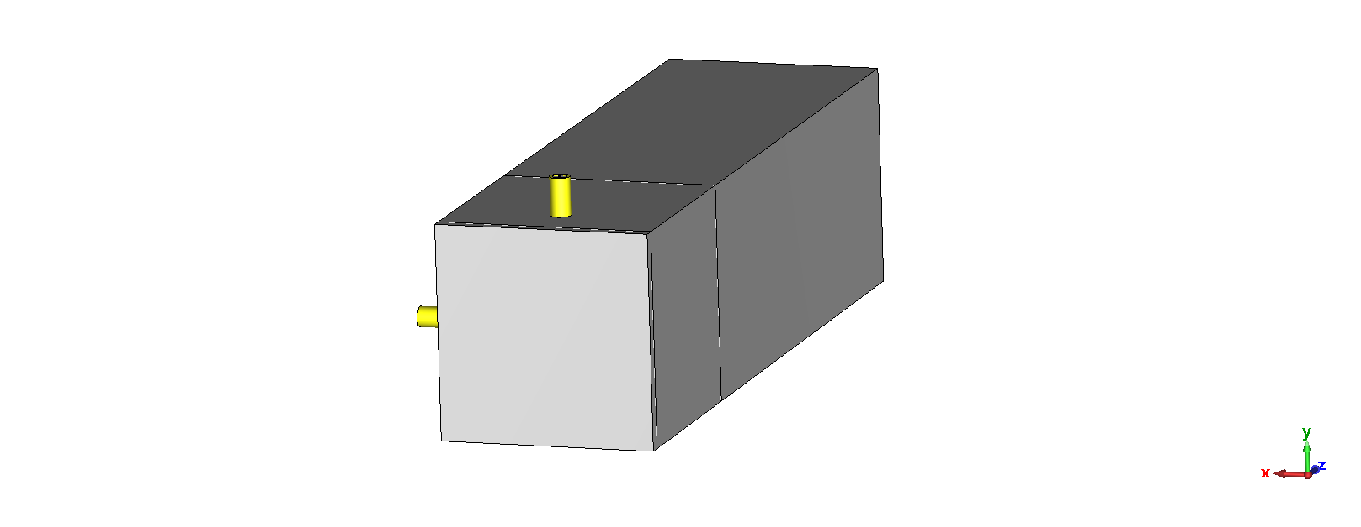
Stage 3 – Coaxial feeds

Slide 18
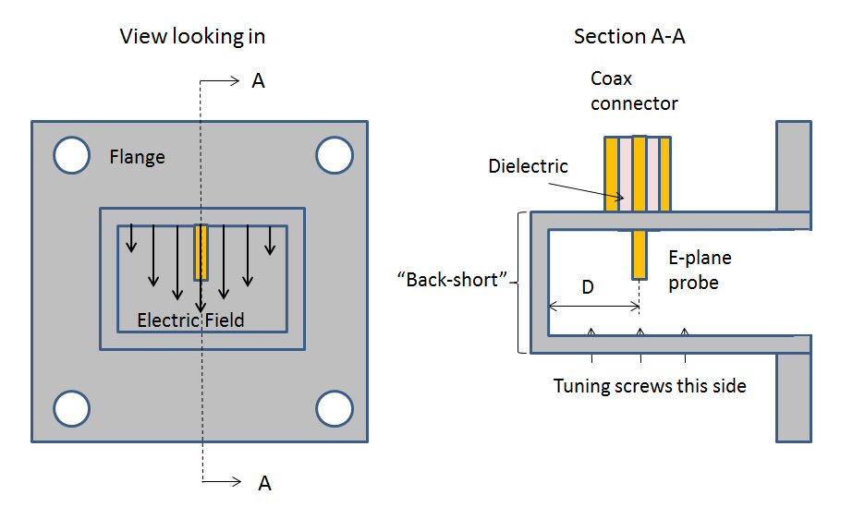
Stage 3 – issues
Probe distance to back-short
Probe distance to polarizer
Probe height
Probe radius
Port isolation

Slide 19
Mode 1 – prototype output

Slide 20
Conclusion
What I have succeeded in:
First prototype
Rough dimensions which allow for fabrication cost estimation
What I am struggling with:
Fine tuning of coax to waveguide transitions
Port isolation

Slide 21
Thank you
for your attention

